Slide 1

“Module: ?
FPS Conversations and Owner Macros”
“Behind every suspicious review lies an investigation that protects millions of travelers.”
@ Module 1
Welcome to Fraud Support Fundamentals

Slide 2

FPS Conversation - Introduction
FPS - Fraud Prevention & Safety / Fraud Policy Support
An FPS Conversation is a specialized ticket or interaction type triggered when a property owner queries, disputes, or seeks clarification regarding fraud-related actions taken on their account or listing.
Example:
A hotel owner notices that Tripadvisor has restricted their account because the fraud system detected suspicious activity, such as a large number of reviews that appear to be fake or manipulated. They contact Tripadvisor asking why the action was taken.
Tripadvisor / FPS Conversations & Owner Macros
1

Slide 3


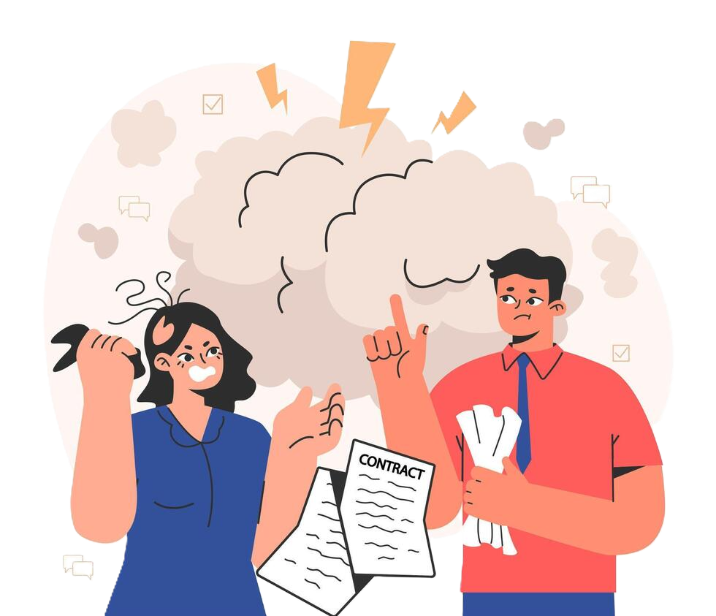

G al of FPS Conversations
Educate the owner about our fraud policies
Address all concerns from the user (Owner)
Encourage compliance with our guidelines to prevent future fraudulent activity
Tripadvisor / FPS Conversations & Owner Macros
2

Slide 4



Who handles FPS Conversations?
Handler ID
Handler ID
Handler ID
The Investigations Team
Fraud Support Tier 1 agents
Fraud Support Tier 2 agents
Tripadvisor / FPS Conversations & Owner Macros
3

Slide 5
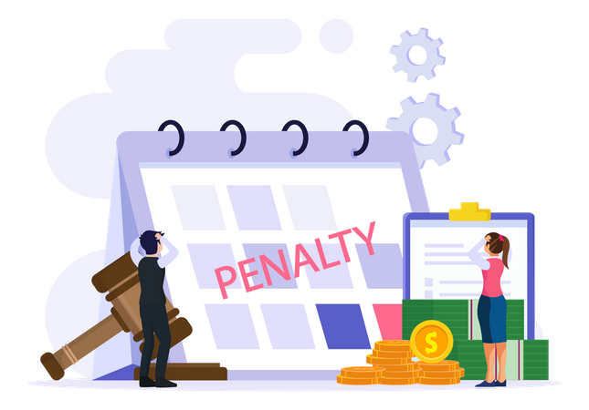





Common FPS scenarios
Owner Responding to Fraud Letter
Owner Support Misdirected & Owner Response Misdirected
Ranking Drop Queries
Verify violation, educate on policies, suggest GCF for mitigation.
Identify owner-written reviews not fraudulent, remove penalty, notify owner.
Check for fraud penalties in the last 12 months; use appropriate macros based on findings
Missing Guest Reviews
Test Reviews
Removed Traveler’s Choice Award
Respond based on fraud activity - active penalty, suspicious pattern, or minimal activity
Handle fraud-related removals as FPS; escalate non-fraud issues
Treat explicitly marked test reviews as non-fraud; remove without penalty
Tripadvisor / FPS Conversations & Owner Macros
4

Slide 6



Common FPS scenarios (Conti…)
General Advice
Default Owner Settings & Staff Contact
Incorrect Penalties
Educate on fraud admissions and SEO patterns in reviews
Manage email updates securely; handle staff disclosures confidentially
Overturn only if 100%
certain of error and no INV involvement
Note: Always prioritize policy enforcement and education over customer satisfaction in FPS cases
Tripadvisor / FPS Conversations & Owner Macros
5

Slide 7
Pre-conversation Checklist
Confirm Affiliation - Verify the individual is an official representative
Confirm which property - Identify the correct property they are discussing
Violation type - Understand the specific policy violation. (Eg: Boosting, Vandalism)
Check for previous mitigation - Review Zendesk history and Guidelines compliance form (GCF) status for prior actions
Identify any required peripheral actions
Check and merge duplicate tickets
Tripadvisor / FPS Conversations & Owner Macros
6

Slide 8
Agent responsibilities
Primary Responsibility
Double Check: Always verify, even if another team already did
Chain Listings (Sub-Brands)
Never Assume: Chain domains (e.g., @hilton.com) do not prove sub-brand affiliation
How to Verify: Check the property’s official website or find verified owners with the same domain
Child/Parent Listings
Automatic Trust: Main attraction owners are assumed to own child attractions
Verify First: Confirm genuine affiliation before starting any conversation
Tripadvisor / FPS Conversations & Owner Macros
7

Slide 9
Key Communication Standards for FPS Interactions
Protect proprietary and confidential information
Provide sufficient info to help identify violation sources
Do NOT share anti-fraud efforts or info protected by privacy agreements
Understand clearly what can/cannot be disclosed
Tripadvisor / FPS Conversations & Owner Macros
8

Slide 10

Information Sharing - Do's
If violations come from registered property owners or staff members close to guests
Type of violation (avoid internal terms)
Rough timing/velocity patterns (no specific dates)
Violation came from the current corresponding email or the property's official domain email
If fraud/warning letters were issued previously
If activity has stopped
If incentive surveys confirm the practice (without identifying specific reviewers)
Review text if written by the same email address and acknowledged by the sender
Penalty duration (except Red Badge cases)
Tripadvisor / FPS Conversations & Owner Macros
9

Slide 11
Information Sharing - Don’ts
Geographic location (domestic/international only)
Review text unless the sender confirms and admits they authored it
Pattern details such as IPs, proxies, passwords
User account details
Exact identity of violator (suggest general departments)
Exact fraud letter emails unless using a corporate domain or matching address
Exact dates of submission or removal
Penalty durations in Red Badge cases
Tripadvisor / FPS Conversations & Owner Macros
10

Slide 12

Information Sharing | Relevant macros
The most relevant macros are in:
Fraud Letter Basic Info
Fraud Letter More Info
The ‘Initial Contact with Owner’ macro contains editable sections:
Example:
"Unfortunately, because of our privacy agreement with all Tripadvisor members, I am unable to share details on what triggered our filters. However, I can tell you that we believe this activity comes from..."
...within your property and it's originated by members of your staff.
...a third-party vendor (webmasters, SEO agents, etc.).
...sophisticated technology that is not commonly associated with average users.
Tripadvisor / FPS Conversations & Owner Macros
11

Slide 13

Peripheral actions
Additional actions taken during case review beyond the original request
Must be documented in internal notes
Typically, not shared with the requester unless relevant
01
02
03
Examples:
Investigate and remove suspicious or fraudulent reviews.
Check and remove duplicate reviews.
Note: Always add a brief comment in internal notes when performing peripheral actions.
Important: Peripheral actions are not predefined and will vary depending on the circumstances of each case.
Tripadvisor / FPS Conversations & Owner Macros
12

Slide 14

Things to avoid during an FPS Conversation
Using Jargons during conversations
Sharing sensitive information with unauthorized individuals
Advising repeated steps to the owners
Note: Reply to owners professionally and neutrally. Acknowledge the inquiry without disclosing internal investigation methods or decision criteria
Tripadvisor / FPS Conversations & Owner Macros
13

